Slide 1
Good fellas
IS436 - 03
PAUL, BENJAMIN,DENSU, JAS, NIELS, TANNER, WILL, ZACH

Slide 2
Process Modeling
Deliverable 3
04-18-2019

Slide 3
Updated - Project Plan
A project plan is an essential document for keeping a project on track.
In our project plan, we identified the scope, goals, deliverables and deadlines of our project.
https://drive.google.com/file/d/1XpE09v3PCGo5PuMXaE6fpmySJL0FymxZ/view

Slide 4
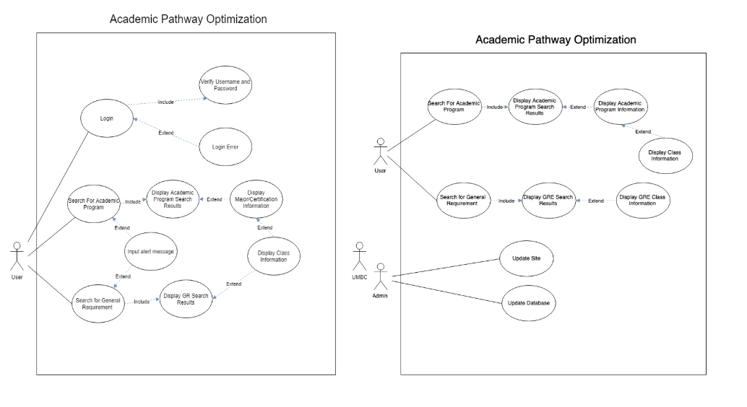
Updated Use Case Diagram

Slide 5
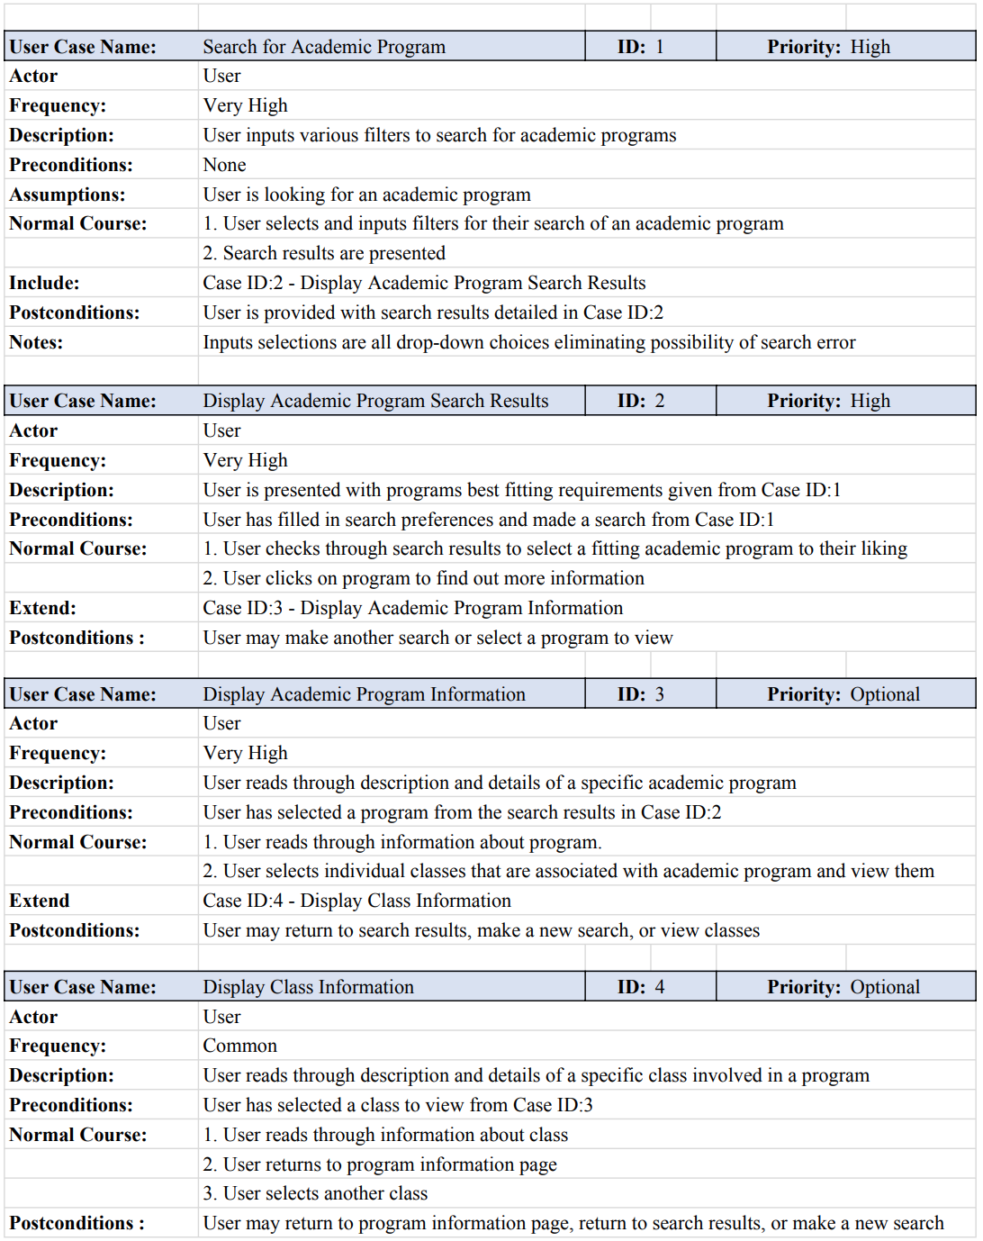
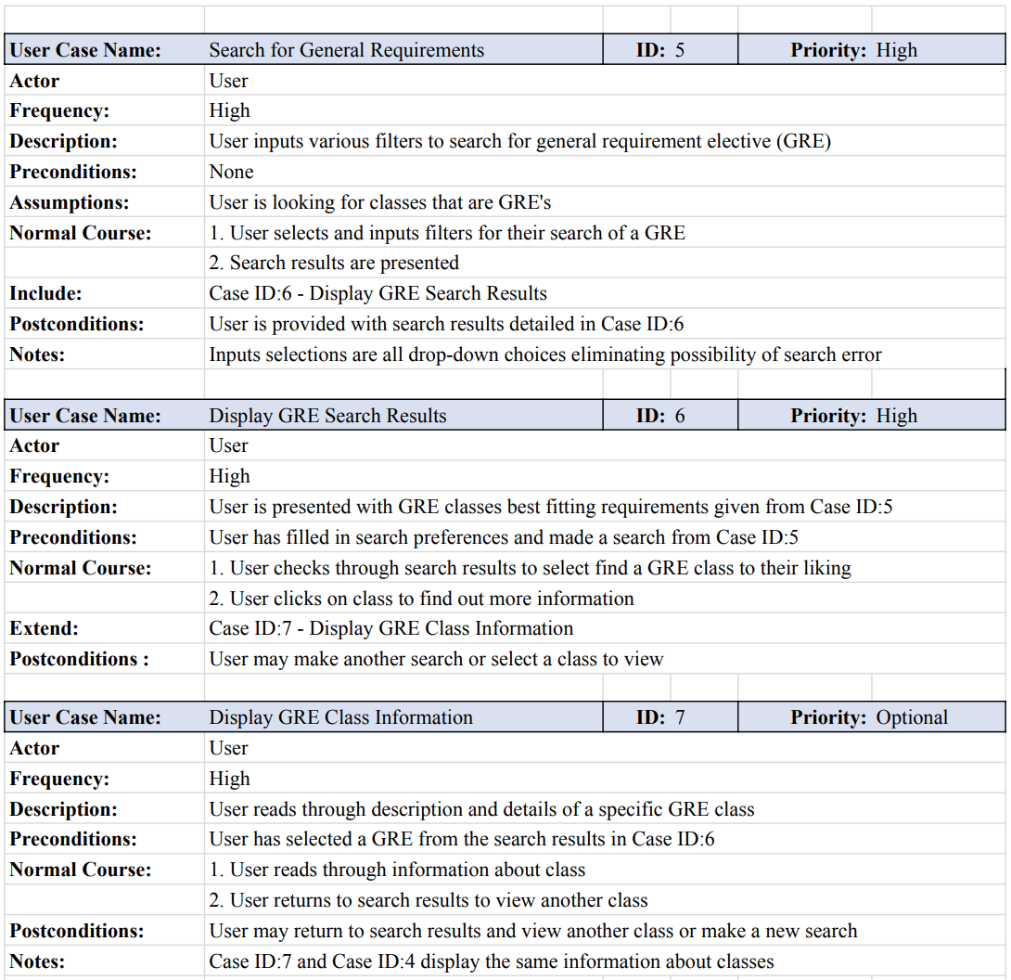
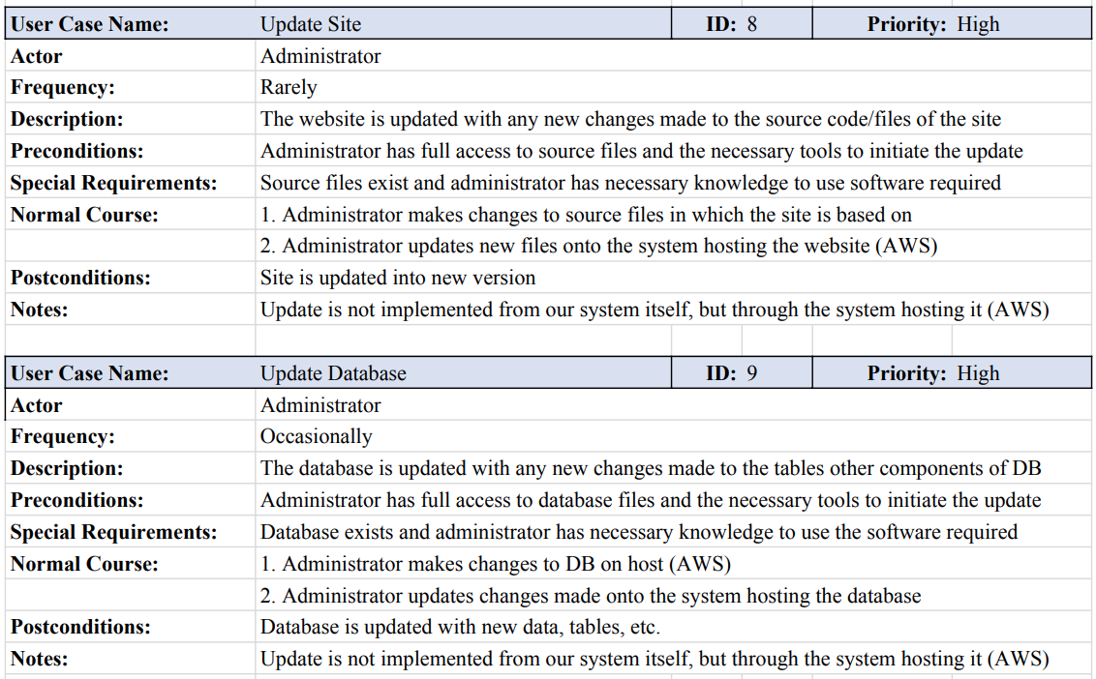
Use Case Documents

Slide 6
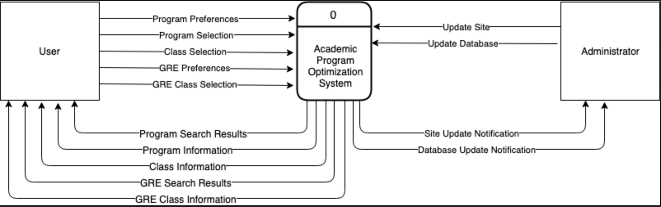
Context Diagram

Slide 7
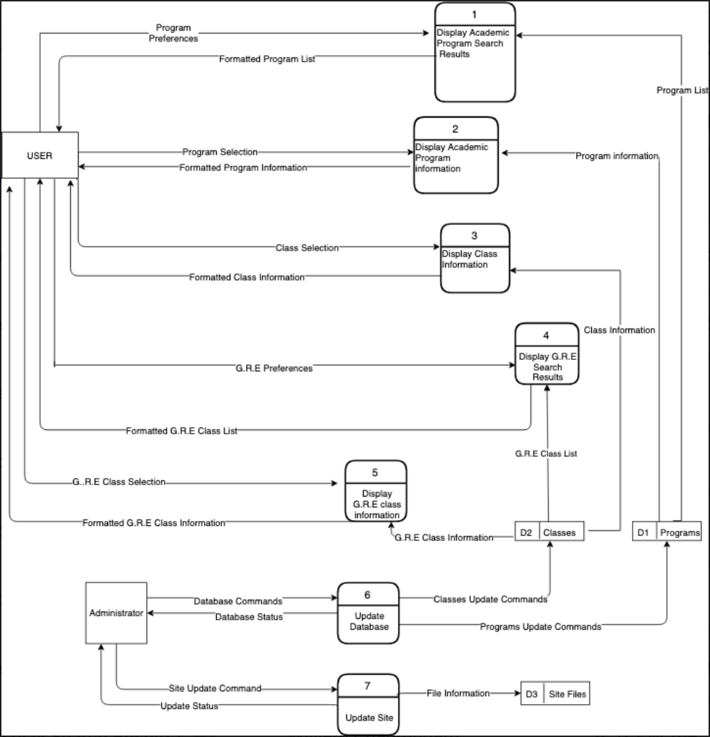
Diagram Level 0

Slide 8
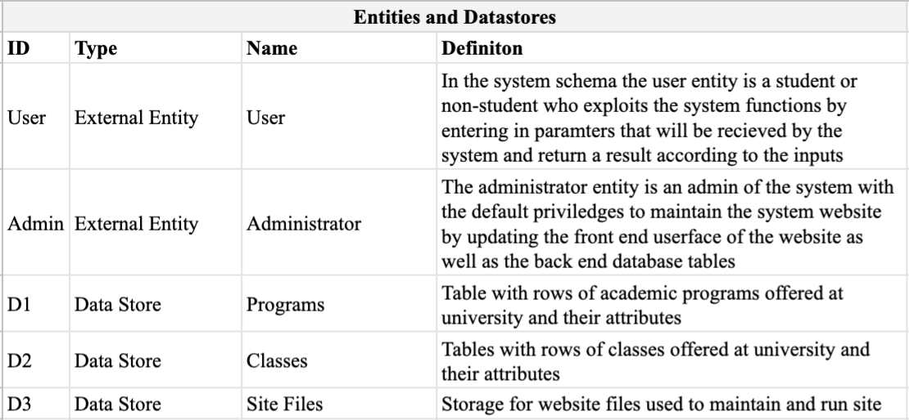
Diagram Level 0 Entity and Datastore Definitions

Slide 9
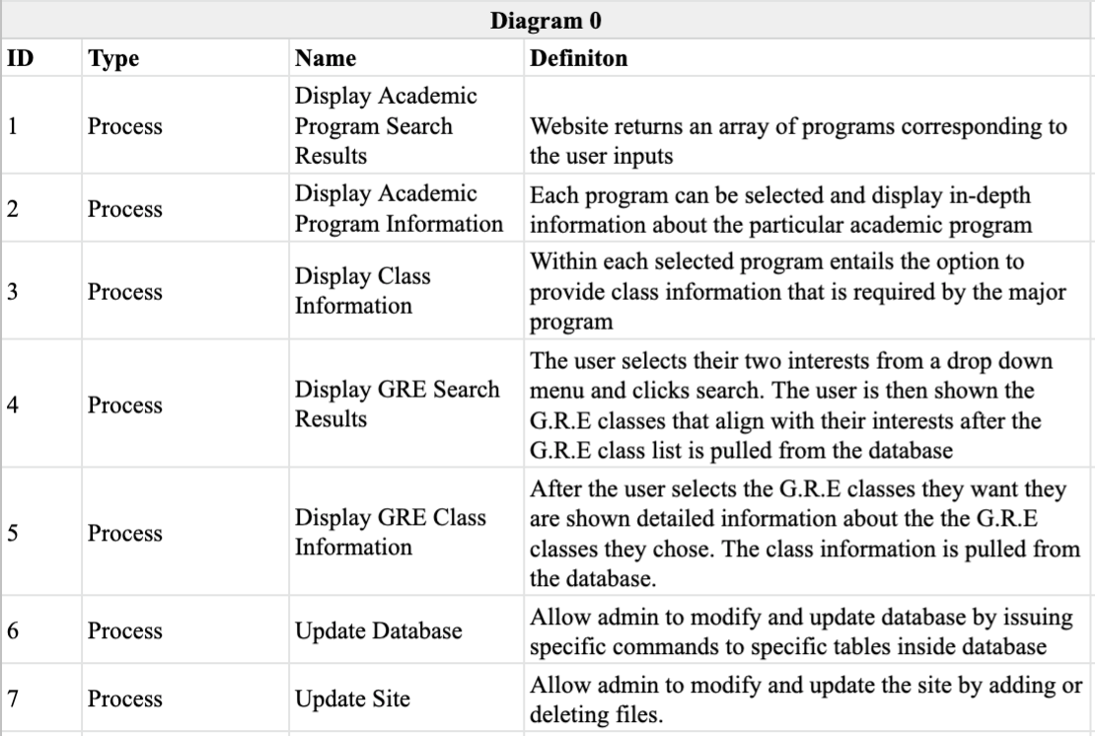
Diagram Level 0 Process Definitions

Slide 10
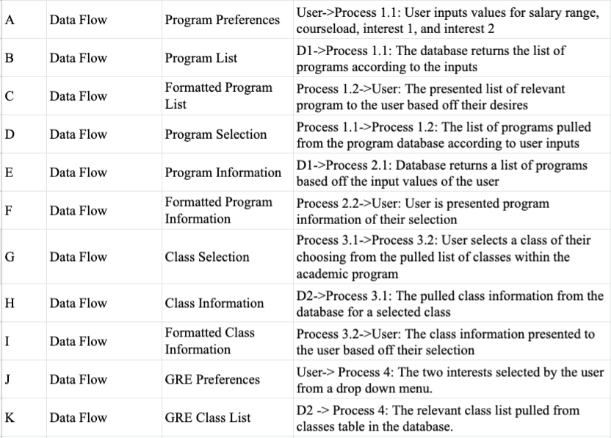
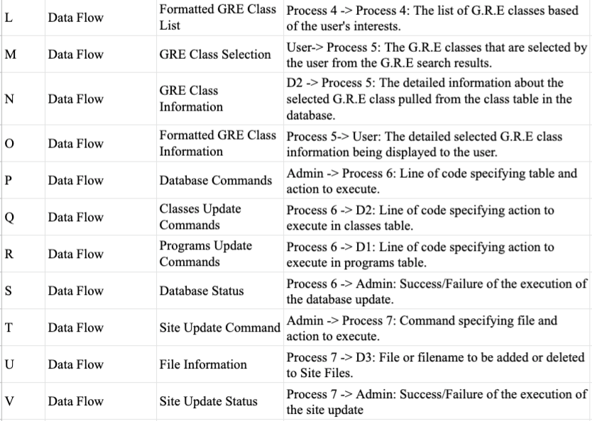
Diagram Level 0 Data Flow Definitions

Slide 11
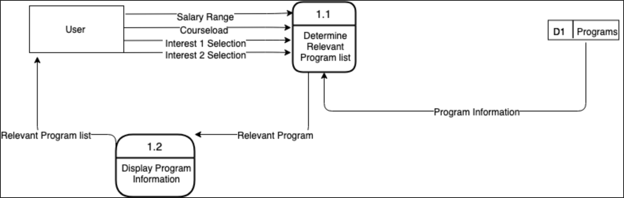
Diagram Level 1: Display Academic Program Search Result

Slide 12
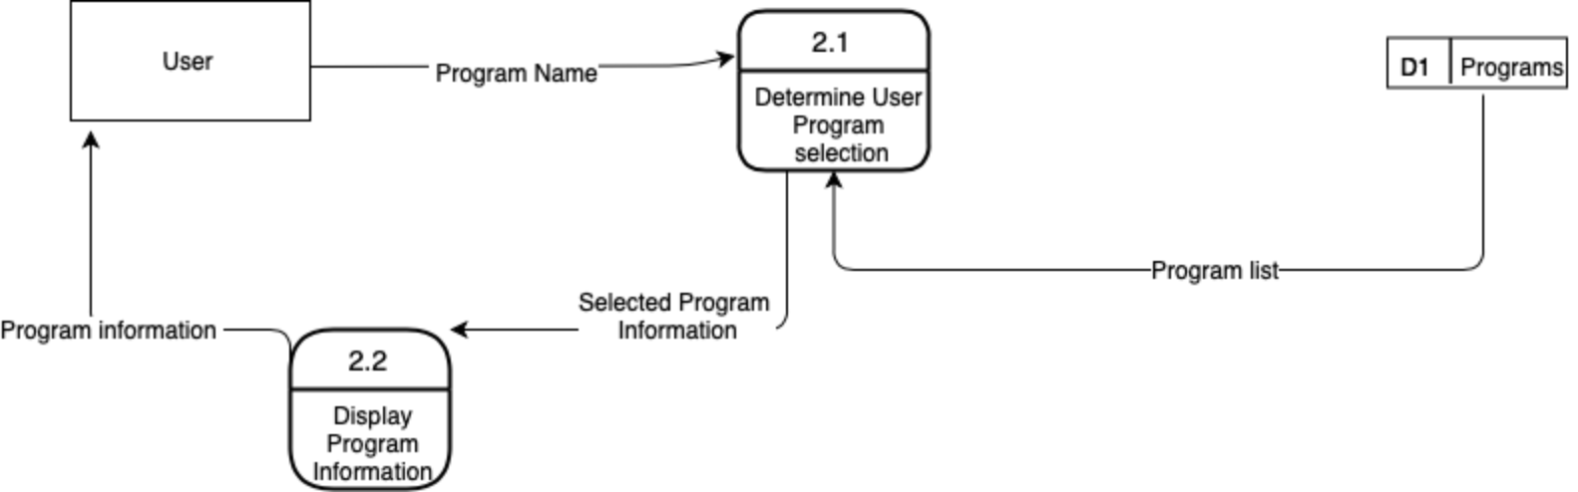
Diagram Level 1: Display Program Information

Slide 13
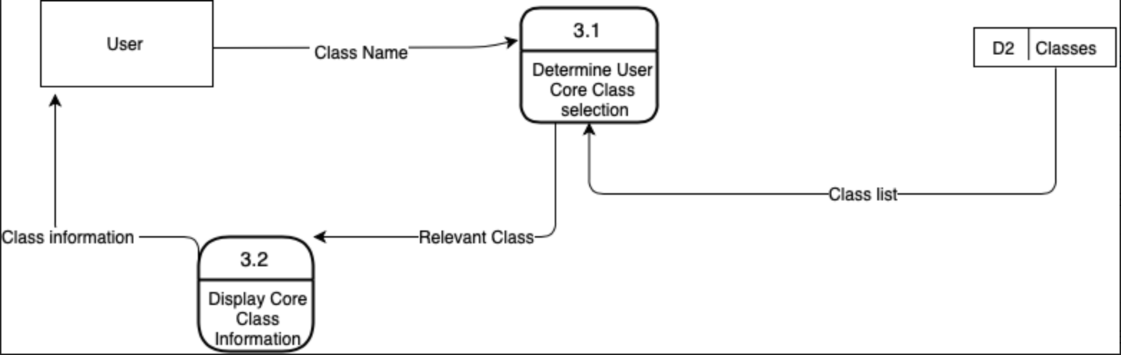
Diagram Level 1: Display Class Information

Slide 14
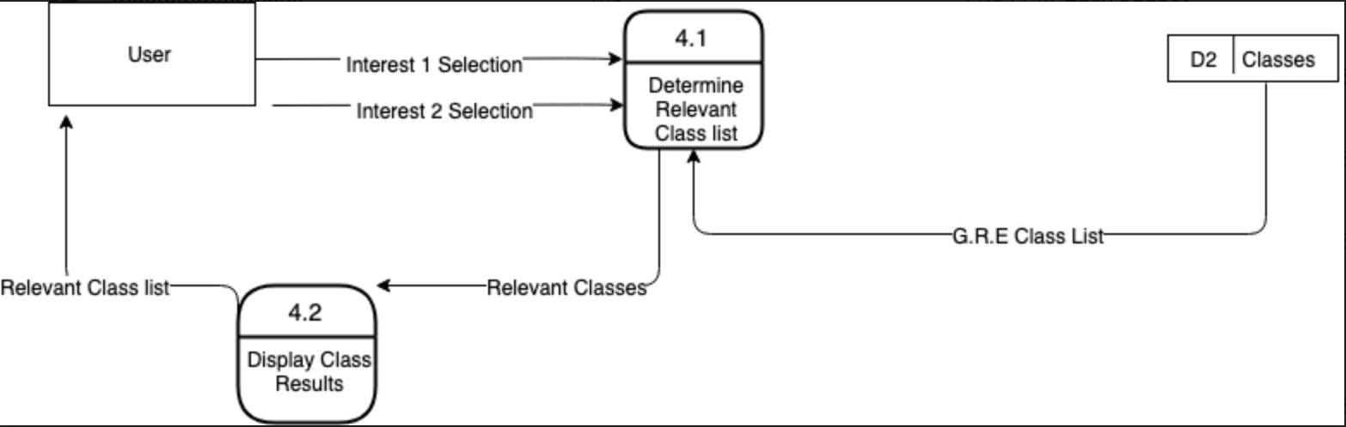
Diagram Level 1: Display GRE Search Results

Slide 15
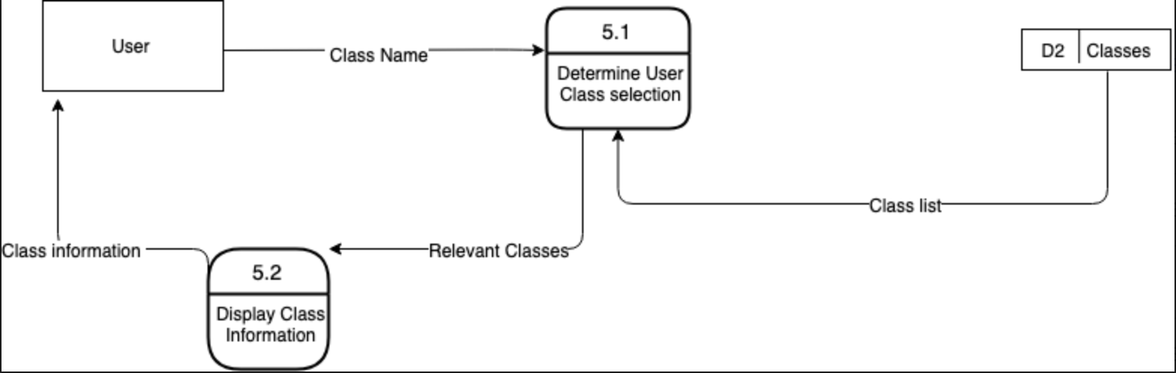
Diagram Level 1: Display GRE Class Information

Slide 16
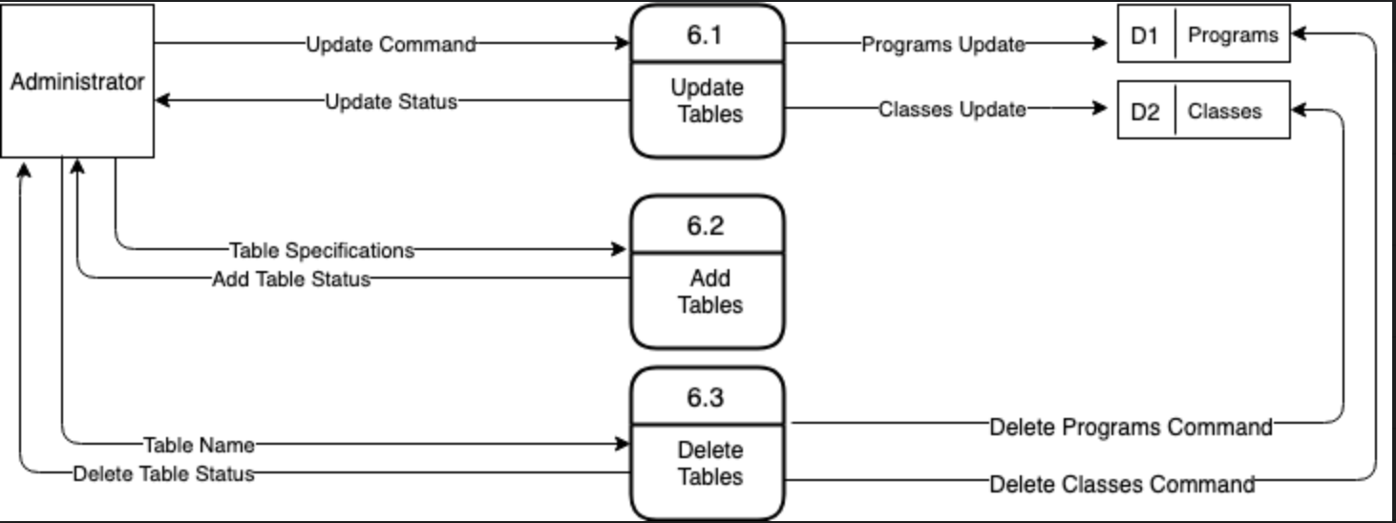
Diagram Level 1: Update Databases

Slide 17
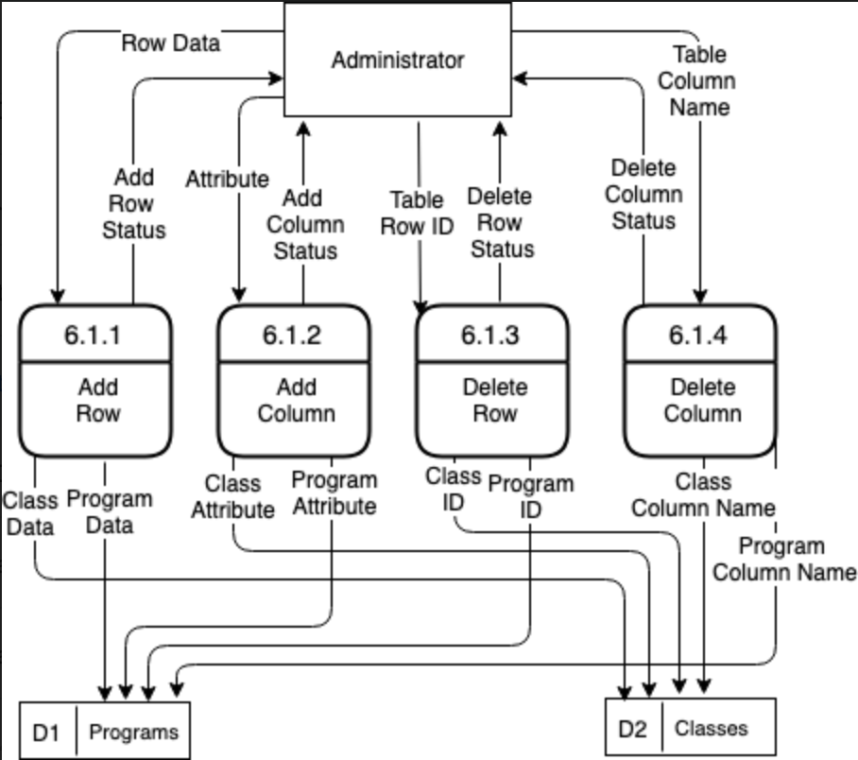
Diagram Level 2: Update Tables

Slide 18
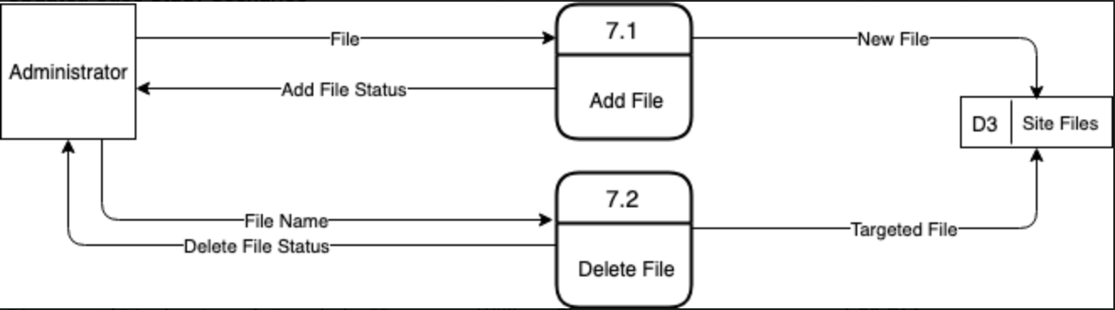
Diagram Level 1: Update Site

Slide 19
Kanban Flow - Link
https://kanbanflow.com/board/sPos7f

Slide 20
Questions??

Slide 21
THANK YOU!

